Slide 1
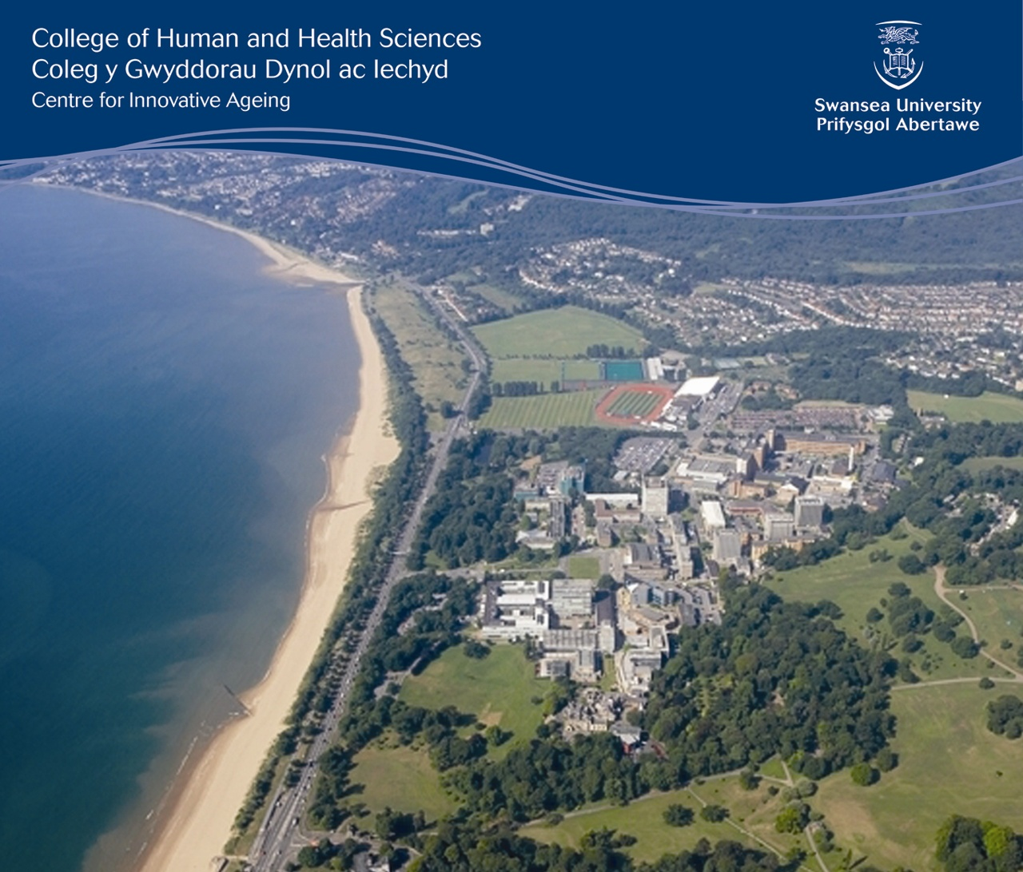
Is the car really necessary for a connected and healthy later life?
Dr Charles Musselwhite
Associate Professor (Reader) in Gerontology, Centre for Innovative Ageing, Swansea University
Deputy Director, OPAN C ymru
c.b.a.musselwhite@swansea.ac.uk
www.drcharliemuss.com
Ageing, Transport and Mobility: New approaches from researchers and providers
Tuesday 29 October 2013
2.00pm-4.00pm,,
G306B, Jean McFarlane Building, the University of Manchester M13 9PL

Slide 2
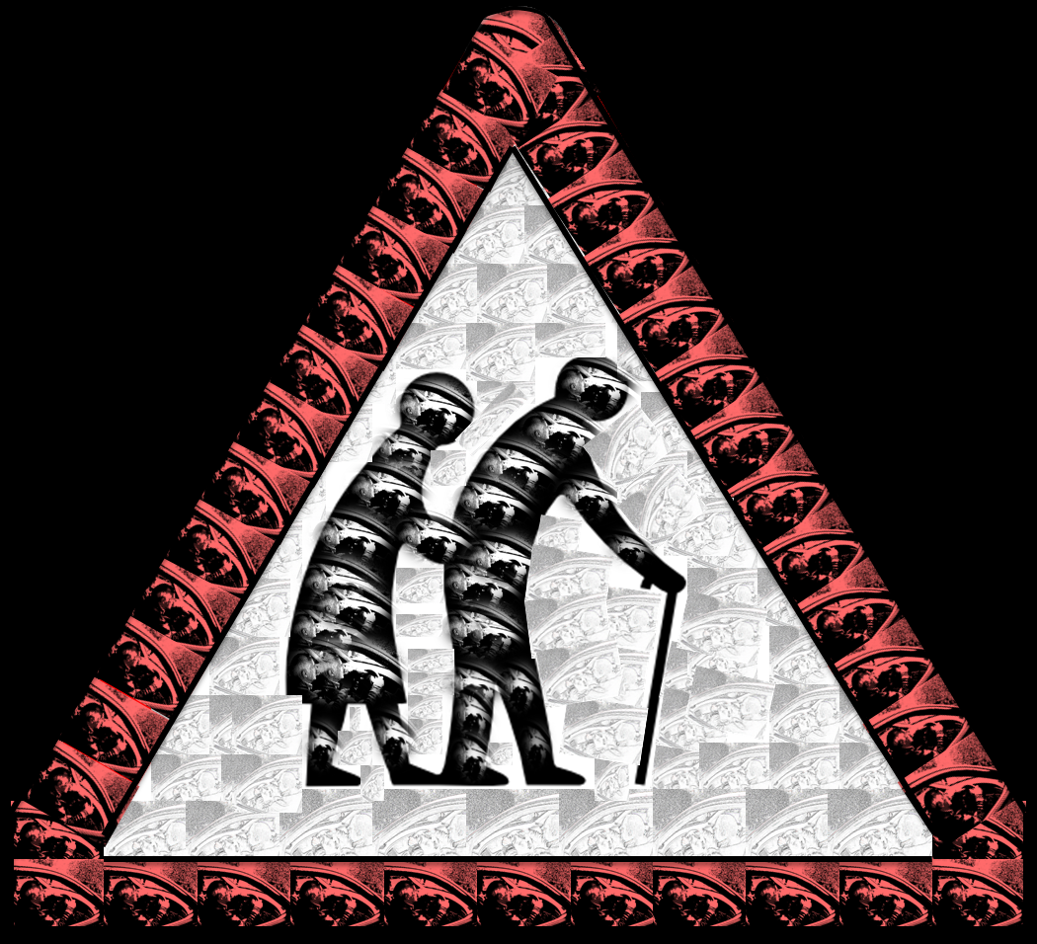
A reduction in mobility can result in an increase in isolation, loneliness and depression and an overall a poorer quality of life. (Fonda, et al., 2001; Ling and Mannion, 1995; Schlag, et al., 1996)
Older people, who are more socially integrated - for example those who are members of social clubs or religious organizations, or those involved in family activities - enjoy better health (WHO, 1999)
But:-
Do you need to use a car in later life to stay connected, healthy and well?
Are there positive stories of mobility in later life?

Slide 3
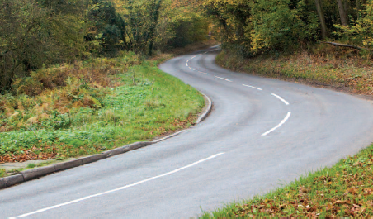
Connectivity: People and Places
Older people’s need to travel

Slide 4
Needs for travel
TERTIARY MOBILITY NEEDS
Aesthetic Needs
e.g. The need for the journey itself, for relaxation, visit nature.
No explicit purpose.
SECONDARY MOBILITY NEEDS
Social/affective Needs
e.g. The need for independence, control, to be seen as normal.
Linked to status, roles, identity, self-esteem. Impression management
PRIMARY MOBILITY NEEDS
Practical/utilitarian Needs
e.g. get from A to B as safely, reliably, cheaply and comfortably as possible.
Musselwhite, C. and Haddad, H. (2010). Mobility, accessibility and quality of later life. Quality in Ageing and Older Adults. 11(1), 25-37.

Slide 5
Older people are more healthy and active as a cohort than ever before and as such are also more mobile (Tomassini, 2004). Increasing hypermobile society, where services, shops, work and families are increasingly dispersed
Increasingly reliant on the car
Growth in % licence holders over 70 years
+37%
-8%
More miles driven per person
Source: DfT (2002, 2006, 2010)

Slide 6
Predicted growth in the use of the car
More older people but also...
More fit, more active, work later in life.
More habitual car users.
Hypermobile society geared around the car
Family and friends dispersed
Estimate of 10,000,000 drivers over 70 by 2030
But is it necessary?

Slide 7
PRIMARY MOBILITY NEEDS
Practical/utilitarian Needs
e.g. get from A to B as safely, reliably, cheaply and comfortably as possible.
Source: National Survey for Wales, January - March 2012
Sample size: 3,500

Slide 8
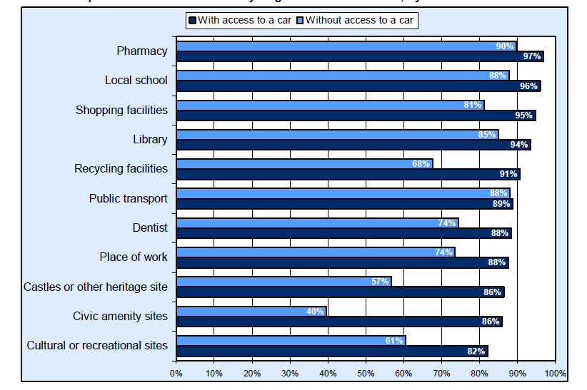
PRIMARY MOBILITY NEEDS
Practical/utilitarian Needs
e.g. get from A to B as safely, reliably, cheaply and comfortably as possible.
Particular issue around not having a car
Source: National Survey for Wales, January - March 2012

Slide 9
PRIMARY MOBILITY NEEDS
Practical/utilitarian Needs
e.g. get from A to B as safely, reliably, cheaply and comfortably as possible.
Those with mobility difficulties make 36% fewer trips
Especially those 70 years+ (Nat Travel Survey GB, 2012)
39% of 70 years+ had problems walking or using a bus,
(4% for those aged16-49) (DfT, 2010a)
11% of people with a long-term illness found it difficult to get to/from GP surgery,
2% for those without a long-term illness. (Nat.Survey Wales, 2013)
Availability of services: c.79% take up statutory bus concession (c.50% in rural areas)
76% of people felt safe on public transport after dark.
Older people felt less safe than younger people and women felt less safe than men. (Nat.Survey Wales, 2013)

Slide 10
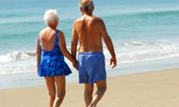
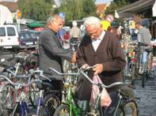
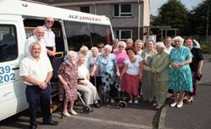
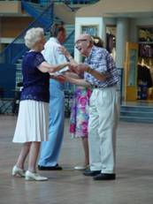
“You can’t ask other people to take you out for “a drive”. They’d think you’d lost their senses. Anyway they have got better things to be doing with their time, then ferrying me about just for the sake, like”
(female, gave-up driving at 80)
A reduction in mobility can result in an increase in isolation, loneliness and depression and an overall a poorer quality of life.
TERTIARY MOBILITY NEEDS
Aesthetic Needs
e.g. The need for the journey itself for relaxation, visit nature, use and test cognitive skills
Especially by car
On giving-up driving this level of needs is adversely affected
Not so easy to ask for discretionary travel
“It’s hard to explain I suppose. You just don’t seem like you belong. I suppose yes there are feelings that you might be ready for the scrapheap now. The first step to it, you know”
(Male, given-up driving at 76)
SECONDARY MOBILITY NEEDS
Social/affective Needs
e.g. The need for independence, control, to be seen as normal.
Linked to status, roles, identity, self-esteem. Impression management
On giving-up driving this level of needs is adversely affected
Isolation, no longer part of society, no longer feel normal
“Well Dorothy and David from number 3 take me shopping every week, we all go, we have a bit of a time of it you know, it’s a kind of outing. I never expected that. ” (Female, gave-up driving at 80)
W-H
PRIMARY MOBILITY NEEDS
Practical/utilitarian Needs
e.g. get from A to B as safely, reliably, cheaply and comfortably as possible.
On giving-up driving –
this level of need is usually met
friends
accessible transport
public transport
teleshopping?
Source: Musselwhite, C. and Haddad, H. (2010). Mobility, accessibility and quality of later life. Quality in Ageing and Older Adults. 11(1), 25-37.
Notes:
So why prolong the driving task for this age group. We already know that the number of drivers on our roads and the number of journeys on our roads are increasing, so shouldn’t we actually be trying to help this age group get out of their cars?
I believe that this is probably true, but only for the right reasons. We live in a society that is increasingly centred around the motor vehicle. As people get older they are beginning to cite an increase with difficulty in accessing services, especially as they are beginning to be cited out of town centres and away from residential zones.
Driving is linked with increased self-confidence, mastery (a sense of achievement) and self-esteem. In addition, feelings of autonomy, protection and prestige, all linked to a sense of control over the environment which as we know from psychological research is linked to maintaining both physical and mental health and indeed to prolonging life.
Needless to say, giving up driving is associated with an increase in depressive symptoms.
I believe that older people should be allowed to continue to drive motor vehicles, appropriately and for necessary journeys, for as long as possible and for as long as it is safe for them to do so.

Slide 11
Traditional Categorisation of Trip Purposes
Travel for Utility
Time wasted: to be minimised
Distance to be overcome
Destination-focussed
Routine
Often Essential, Productive
“Essential”
Economic
Priority
Travel for Tourism
Novel
Enriching
Less destination focussed
U T I L I T Y
Not
‘Transport’
“Discretionary”
Economic
Priority
Tourist

Slide 12
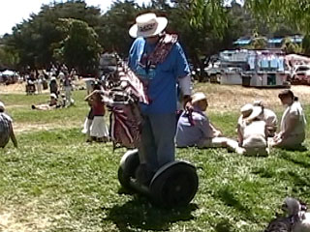
Successful stories

Slide 13
Musselwhite, C.B.A. & Shergold, I. (2013). Examining the process of driving cessation in later life. European Journal of Ageing. 10(2), 89-100
(i)
LONG TERM
7(2m; 5f)
(ii)
SHORT TERM
8 (4m; 4f)
(iii)
REACTIVE
6 (6m; 0f)
The trigger is associated with external social events
Respected family member
Health condition
Keys taken by relatives
1st stage
Trigger
Don’t gather much information, at all (Trail and error ; Rely on lifts; Reciprocation)
They were not actively searching for information (All had relied on others to tell them about walking and using public transport. That type of transport is not for them)
2nd stage
Info Gathering
Meticulous planning (no near-by family and friends or fiercely independent)
3rd Stage
Consolidate
Largely trial and error. Supportive
Enjoy a challenge family&friends
Bitter and angry
HIGHER QoL
LOWER QoL
“I’ve re-discovered my local area. Which is great. I forgot what the village has to offer. In fact I think it is better than a few years ago. But not using the car has forced me to use more local things.” (female, 75)
“The bus out is a real bit of fun. I go on it with friends... and we have a day out” (female, 70)
“I don’t go to football no longer. I’d need to change buses and can’t be doing with the palaver” (male, 85)

Slide 14
Successful at giving-up driving
Plan in advance
“I’ve re-discovered my local area. Which is great. I forgot what the village has to offer. In fact I think it is better than a few years ago. But not using the car has forced me to use more local things.” (female, aged 75)
“The bus out is a real bit of fun. I go on it with friends... and we have a day out” (female, aged 70)
Trial and error
Support of family and friends
Multimodal
Re-engage in immediate locale
Literal
Potential
Virtual
Imaginative
Musselwhite, C.B.A. & Shergold, I. (2013). Examining the process of driving cessation in later life. European Journal of Ageing. 10(2), 89-100
Parkhurst, G., Galvin, K., Musselwhite, C., Phillips, J., Shergold, I., Todres L. (forthcoming) Beyond Transport: Understanding the Role of Mobilities in Connecting Rural Elders in Civic Society in Hennesey, C., Means, R., Burholt, V., (Eds). Countryside Connections: Older people, Community and Place in Rural Britain. Policy Press, Bristol.

Slide 15
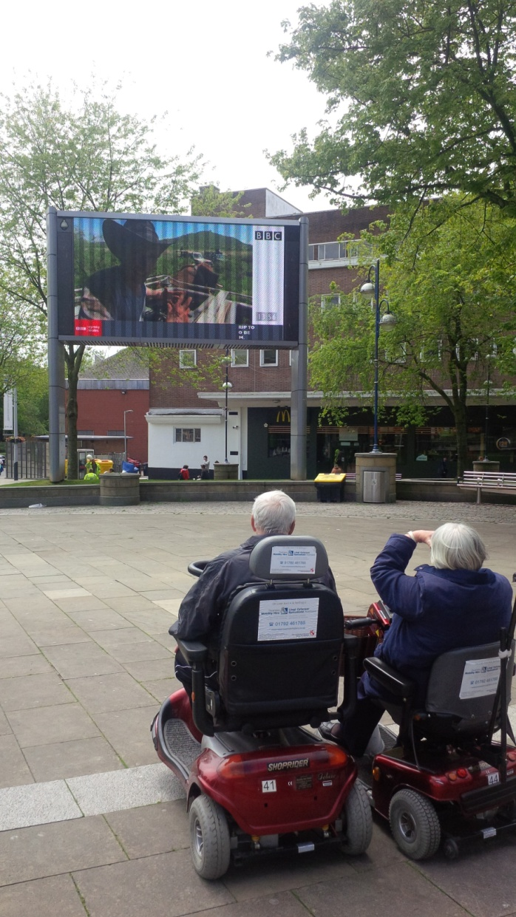
You don’t have to use a car but it helps if...

Slide 16
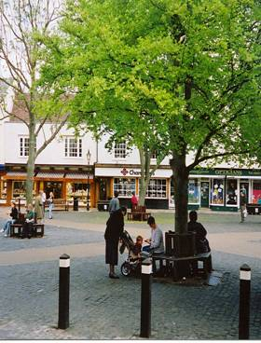
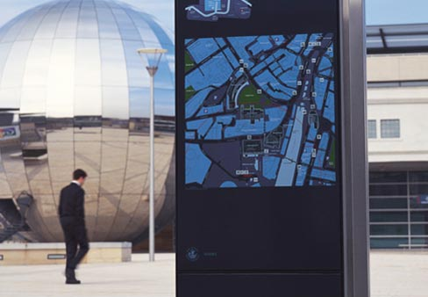
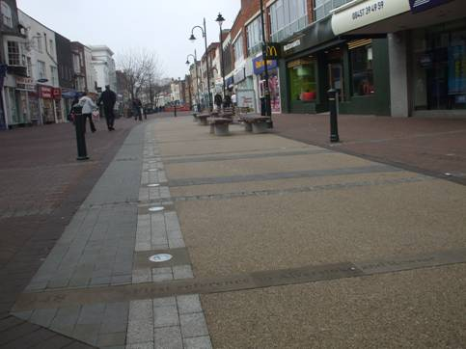
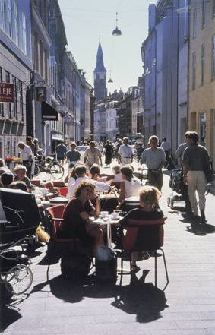
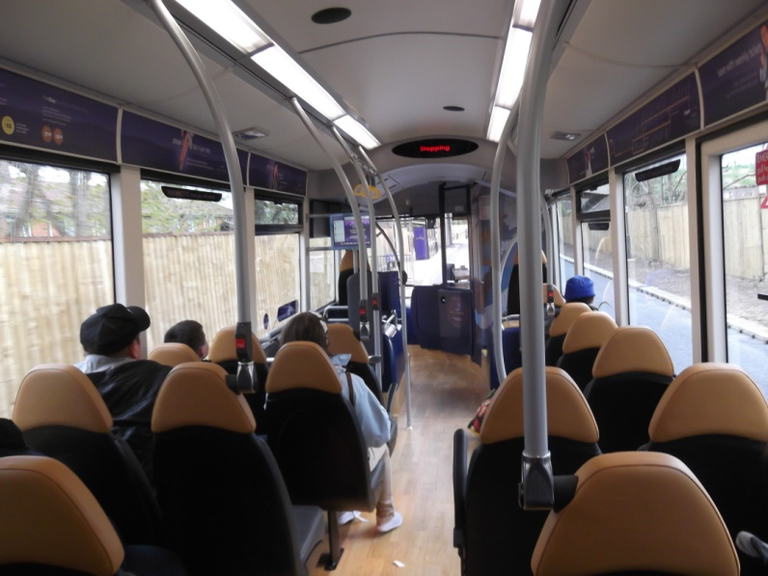
Literal
Pedestrian
There is a safe public realm for walking
There is a desirable public realm for walking
Quality, desirable public transport is provided and is accessible
Alternatives are available and attractive
Mobility scooters, community transport

Slide 17
Potential
Alternatives consider the immediacy of the car
Metz (2000)
Use if necessary
Drive few miles but keep car despite cost
“potential travel - knowing that a trip could be made even if not actually undertaken” is an important element of mobility. (pg 150)
Davey (2007)
the possible need to travel at short notice to respond to family emergencies, or “journeys ‘on a whim’ for pleasure or aesthetic enjoyment”. (pg. 50)
Andrews (2011) – free bus pass
it works someway to creating a sense of freedom and independence for travel unconstrained by financial burden.
I kept my driving licence, there is no reason why I shouldn’t.... but I consider that my reflexes aren’t good enough for driving, I don’t need to drive, she can drive, but I kept my driving licence in case there was an emergency and I had to drive” (Male 80s)
“....it is actually a social thing because you meet up with people and you can sit there and admire the view on the way. It's like being chauffeur-driven on the bus. You can stop for coffee and sandwiches... I haven’t done it myself. (Male late 60s)

Slide 18
Virtual
There are replacements on the Internet to reduce actual mobility
Webcams
Virtual Environments
TERTIARY TRAVEL NEEDS
Aesthetic Needs
The need for relaxation, visit nature, test cognitive skills
Least awareness
SECONDARY TRAVEL NEEDS
Social Needs
The need for independence, control, status, roles
Social networking
PRIMARY TRAVEL NEEDS
Practical Needs
Make appointments, access shops and services, work
Most awareness
Shopping online
E-health
Tele-working

Slide 19
Virtual
Potential
Increase in technology and networking
Increased accessibility
Increased use – buying, talking, making friends, “visiting”, watching, interacting
Own time
Challenges
What is missing from the “virtual” world compared to “reality”?
Touch, smell, sense, continuity, impression managed, staged
Informal, random, chance meetings
Equal access?
Parkhurst, G., Galvin, K., Musselwhite, C., Phillips, J., Shergold, I., Todres L. (forthcoming) Beyond Transport: Understanding the Role of Mobilities in Connecting Rural Elders in Civic Society
in Hennesey, C., Means, R., Burholt, V., (Eds). Countryside Connections: Older people, Community and Place in Rural Britain. Policy Press, Bristol.

Slide 20
Imaginative
People are part of safe, attractive and desirable local communities
Parkhurst, G., Galvin, K., Musselwhite, C., Phillips, J., Shergold, I., Todres L. (forthcoming) Beyond Transport: Understanding the Role of Mobilities in Connecting Rural Elders in Civic Society in Hennesey, C., Means, R., Burholt, V., (Eds). Countryside Connections: Older people, Community and Place in Rural Britain. Policy Press, Bristol.

Slide 21
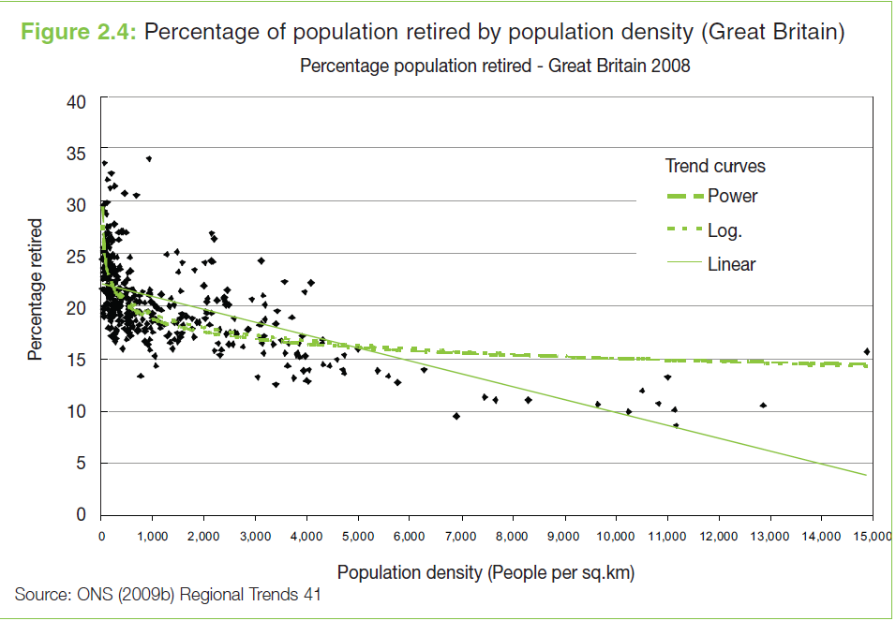
You live in an urban area?

Slide 22
Needs for travel Rural area
You live in an urban area?
Not necessarily!
Rural provision
TERTIARY MOBILITY NEEDS
Aesthetic Needs
e.g. The need for the journey itself for relaxation, visit nature, use and test cognitive skills
Imaginative/Dunroamin’
SECONDARY MOBILITY NEEDS
Social/affective Needs
e.g. The need for independence, control, to be seen as normal.
Linked to status, roles, identity, self-esteem. Impression management
PRIMARY MOBILITY NEEDS
Practical/utilitarian Needs
e.g. get from A to B as safely, reliably, cheaply and comfortably as possible.
Sporadic alternative provision, distances to overcome, loss of local shops
Musselwhite, C. and Haddad, H. (2010). Mobility, accessibility and quality of later life. Quality in Ageing and Older Adults. 11(1), 25-37.

Slide 23
Needs for travel urban area
You live in an urban area?
Not necessarily!
Urban provision
TERTIARY MOBILITY NEEDS
Aesthetic Needs
e.g. The need for the journey itself for relaxation, visit nature, use and test cognitive skills
Seen as discretionary
SECONDARY MOBILITY NEEDS
Social/affective Needs
e.g. The need for independence, control, to be seen as normal.
Linked to status, roles, identity, self-esteem. Impression management
PRIMARY MOBILITY NEEDS
Practical/utilitarian Needs
e.g. get from A to B as safely, reliably, cheaply and comfortably as possible.
Good proximity to services, variety of alternatives to the car
Musselwhite, C. and Haddad, H. (2010). Mobility, accessibility and quality of later life. Quality in Ageing and Older Adults. 11(1), 25-37.

Slide 24
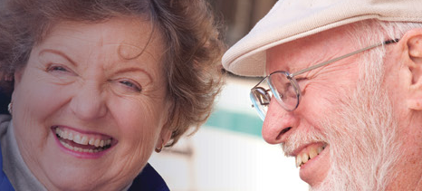
Conclusion

Slide 25
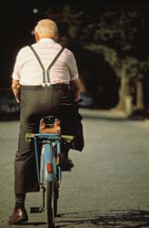
to be mobile is to participate in society
movement may not have an explicit, conscious purpose
there are physical and mental health benefits to maintaining walking, cycling and public transport
All of these are important to quality of life and wellbeing in later life

Slide 26
Recommendations
Recognising the importance of travel beyond the need to get from A to B – role for policy and practice to embrace the social and aesthetic needs
Recognising the importance of considering the need for giving-up driving early-on in life and the need to give-up gradually and ensuring locus of control stays with the individual - role for Travel Awareness Group beyond Driver Training
Making alternatives physically accessible but also psychologically desirable – role for Active Travel Bill
Helping older people learn the norms associated with travelling by other means than the car – Travel Awareness Group

Slide 27
References
Box, E., Gandolfi, J., and Mitchell, K. (2010). Maintaining Safe Mobility for an Ageing Population. RAC Foundation: London.
Gilhooly, M.L.M., Hamilton, K., O’Neill, M., Gow, J., Webster, N., Pike, F. and Bainbridge, C. (2002) Transport and ageing: Extending quality of life via public and private transport. ESCR Report L48025025, Brunel University Research Archive. Available at: http://v-scheiner.brunel.ac.uk/bitstream/2438/1312/1/PDF%20ESRC%20Transport%20Final%20Report.pdf
Hawley, C. (2010). The Attitudes of Health Professionals to Giving Advice on Fitness to Drive, Road Safety Research Report 91, London: Department for Transport.
Musselwhite, C. (2011) Successfully giving up driving for older people. Discussion Paper. International Longevity Centre - UK. Musselwhite, C. B. A. and Haddad, H. (2010). Exploring older drivers’ perceptions of driving. European Journal of Ageing. 7(3), 181-188
Musselwhite, C. and Haddad, H. (2010). Mobility, accessibility and quality of later life. Quality in Ageing and Older Adults. 11(1), 25-37.
Musselwhite, C.B.A. & Shergold, I. (2013). Examining the process of driving cessation in later life. European Journal of Ageing. 10(2), 89-100
Musselwhite, C. (2011). The importance of driving for older people and how the pain of driving cessation can be reduced. Journal of Dementia and Mental Health, 15(3), 22-26.
Musselwhite, C.B.A. (2010). The role of education and training in helping older people to travel after the cessation of driving International Journal of Education and Ageing 1(2) , 197-21
Parkhurst, G., Galvin, K., Musselwhite, C., Phillips, J., Shergold, I., Todres L. (forthcoming) Beyond Transport: Understanding the Role of Mobilities in Connecting Rural Elders in Civic Society in Hennesey, C., Means, R., Burholt, V., (Eds). Countryside Connections: Older people, Community and Place in Rural Britain. Policy Press, Bristol.
Shergold, I., Parkhurst, G., Musselwhite, C., (2012). Rural car dependence:an emerging barrier to community activity for older people? Transport Planning & Tech., 35 (1), 69-85
Siren, A. & Hakamies-Blomqvist, L. (2005). Sense and sensibility : a narrative study of older women’s car driving. Transportation Research, Part F: Traffic Psychology and Behaviour, 8, 213–28

