Slide 1
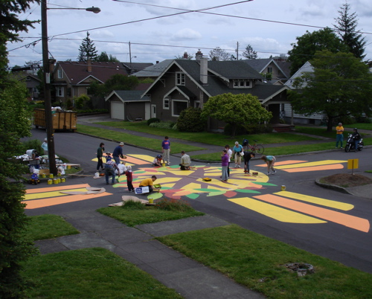
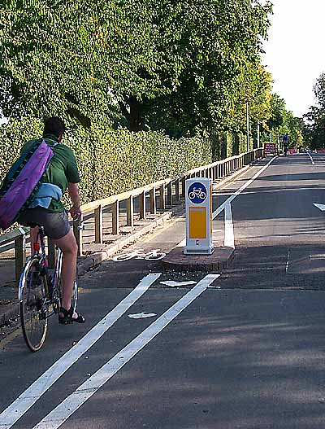
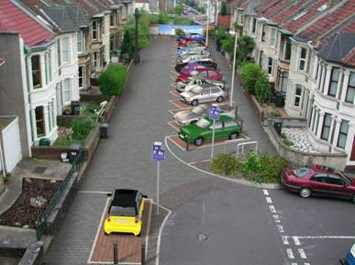
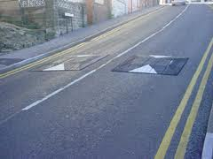
The 3 Es and Road Safety Policy
Developing a road safety audit
Traffic management and the Environmentt
Dr Charles Musselwhite

Slide 2
Content
Reason for accidents
  Road environment
  Skill
  Attitudes
Interventions for improving road user safety
  Education
  Enforcement
  Engineering
Policy and Strategies for road user safety
  UK policy
  Vision Zero
Road safety audit

Slide 3
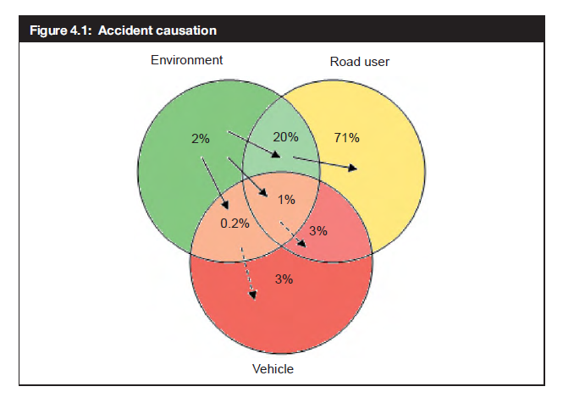
Road casualty causation
Skill
  Experience and development
  Training
Attitude
  Norms and peer pressure
  Education, enforcement
Infrastructure
  Engineering
ROAD USER (95%)
Causes of road casualties
SKILLS
ATTITUDES
ROAD ENVIRONMENT (23%)

Slide 4
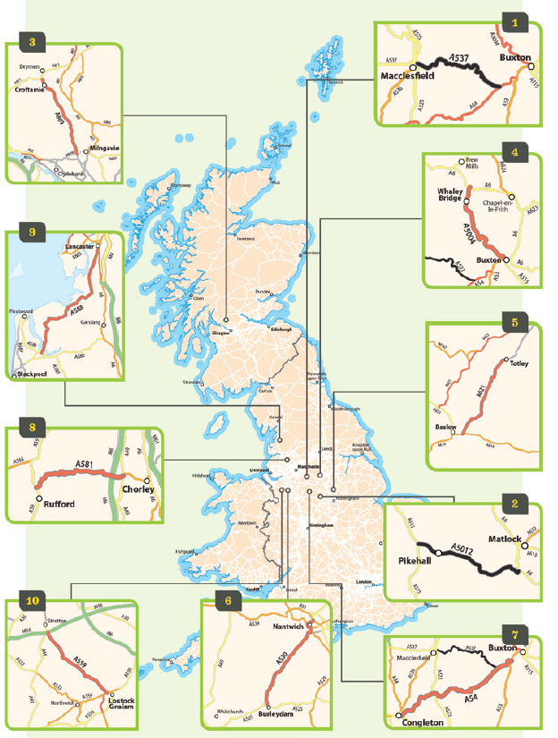
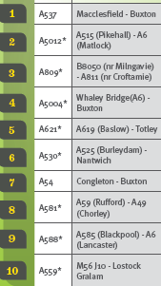
Britain’s most dangerous roads
ROAD ENVIRONMENT

Slide 5
Worst road. Why?
ROAD ENVIRONMENT
A537 through the Peak District,
  known as the Cat and Fiddle,
  had severe bends, steep falls from the carriageway and was edged by dry-stone walls or rock face for almost all its length.
  Fatal and serious collisions on the route - popular with tourists, goods vehicles and motorcyclists - rose from 15 in the three years to 2005 to 34 between 2006 and 2008.
  Single carriageway A road.
  Most crashes happened at weekends during the summer in dry, daylight conditions.

Slide 6
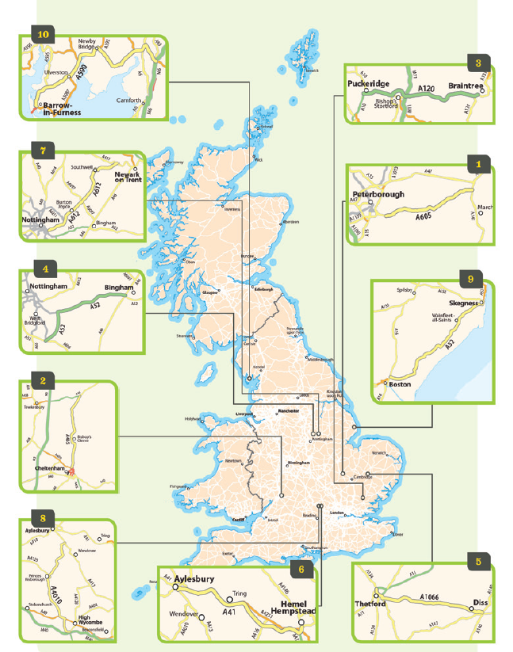
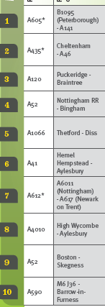
Most improved roads

Slide 7
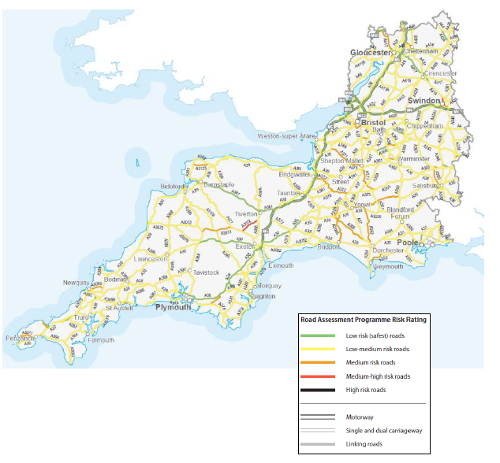
ROAD ENVIRONMENT

Slide 8
Roads and deaths
ROAD ENVIRONMENT
19% of traffic was on motorways, but this accounts for 5% of casualties
38% of deaths occurred on rural A roads with 62% on all rural roads – but only 40% of the traffic
Nearly 60% of all casualties occur on urban roads
Notes:
This bar chart compares traffic with different kinds of casualty by road type.
So can see that blue bars for killed out of proportion to purple bars for rural ‘A’ roads and rural other roads.
Serious (green) and Slight (red) high in proportion to traffic for urban roads.
Motorways are very safe.

Slide 9
Design of streets and environment
ROAD ENVIRONMENT
Areas of high road user accidents tend to be characterised by:
Large open carriage way for vehicles.
Areas of mixed land-use
Areas where houses have little or no outside areas for recreation.
No segregation of heavy volume traffic from pedestrian and other light traffic.
Housing and streets where pedestrian and other travellers’ safety has not been considered and were often designed pre-motor-vehicle. Hence greater on-road parking and narrow pavements increase road user conflict and increases the potential for accidents (Christie 1995).
Crossing of main roads to get to services increases road user danger
  it has been found that children from families with the lowest quarter of income cross 50% more roads than those in families in the highest income quarter (Judge and Benzeval, 1993; White et al., 2000).

Slide 10
Skill Deprivation
SKILLS
Self-reported skill
Everyone better than the average driver!
  Can this be the case?
Objective studies suggest
  Poor hazard prediction
  Close focus of gaze
  Inability to multi-task
  High level of concentration on primary order tasks, leaving little processing for other areas of skill.
    Steering
    Gear changing

Slide 11
Novice driver eye gaze and fixation
SKILLS

Slide 12
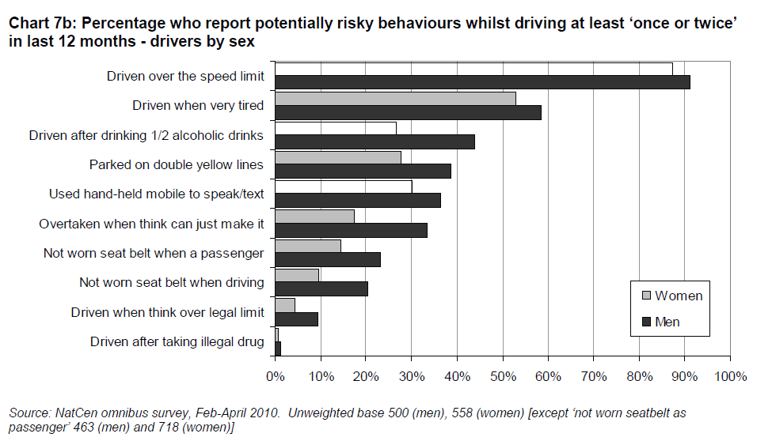
SKILLS
But does not show why there should be differences between male and female road users.
Need to turn to attitudes and other psychosocial variables

Slide 13
ATTITUDES
Self versus others
The public know that driver behaviour is a major contributory factor in the vast majority of road accidents
(Cauzard, 2003)
but there is a consistent view that others drive in a more risky manner than individuals themselves do
(King and Parker, 2008)
Not just driving – older children and adolescents think they have good attitude and skills towards road safety but believe that others especially those in their peer group do not
(Tolmie. 2006).
Notes:
They know that road user behaviour and driving behaviour, in particular, is a contributory factor to almost all accidents, but overall there is a feeling that others are more risky than oneself. So, already we see Self verses others being present. Where the self is safe and others are the danger. This is true especially of driving behaviour but also is evident in other areas of road user safety (e.g. Tolmie, 2006) adolescent pedestrians.
For drivers safety is a key concern. 6 of top 8 concerns are safety orientated of which 4 are directly related. In addition, 3 of these 4 are safety related in terms of safety of other drivers. (see next slide)

Slide 14
ATTITUDES
Self versus others
Individuals do not believe they are dangerous on the roads
And
Believe others are a danger on the roads
I am not likely to be responsible for an accidents, others are likely to be responsible. Therefore little I can do.
Hence, less likely to need to “plan to avoid them”
Campaigns aimed at dangerous driving are for “other” drivers not themselves.
Such campaigns re-emphasise this difference (2CV, 2008 and Flaming Research, 2008)
The third-person effect (Davison, 1983).
High support for enforcement, engineering solutions and education
But not for themselves - for other people.
Notes:
This view has consequences. If people believe they are safe AND other people are dangerous then they are less likely to see the need to plan for accident or collision avoidance. Others are responsible for accidents not themselves. Hence, campaigns are viewed to be AIMED at OTHER people not themselves further emphasising that it is others who are dangerous not them themselves.
This has been termed the third-person effect - where people believe interventions are aimed at other people and as such react in a way to which they perceive the message has effected others (and hence may conform to this or go against it).
Hence, we see high support for enforcement, engineering and education (more of which in a little while) but this can be hypothesised to be support so that OTHER people can use them not THEMSELVES.

Slide 15
ATTITUDES
Norms
Positive attitudes to the speed limit and dangers of speeding
90% agree “important that people drive within the speed limit” (British Attitudes Survey, 2005 in DfT, 2008)
39% agree it is dangerous to drive over the speed limit at all (Angle et al., 2007)
76% of drivers completely agree that driving too fast for the conditions is dangerous (Angle et al., 2007)
Public support tougher enforcement of speeds especially in residential areas and surrounding schools (Brake, 2004; Higginson, 2005; Holder n-d; Quimby, 2005)
77% support 20mph zones (British Attitude Survey, 2007 in DfT, 2008)
On the whole, the public have good knowledge of the speeding and accident link (Brake, 2004; Fuller, Bates et al., 2008; Higginson, 2005; Holder n-d; RAC, 2007; Quimby, 2005;)
But drivers continue to drive over the speed limit
A conservative estimate suggests 49% of drivers continue to drive over the speed limit in 30mph zones and on motorways (DfT, 2009)
Notes:
With regards for Norms on the road, we see the importance of adhering to norms rather than rules in a number of situations, not least with regards to driving and especially in terms of speeding behaviour. There is high support for maintaining speed, and people note how dangerous it is to speed and how there ought to be greater enforcement.

Slide 16
ATTITUDES
Norms
Why?
Driving over the speed limit is not necessarily “speeding”
  Speeding is 1mph over (33%); speeding is 5mph over (33%) (Higginson, 2005)
  10mph over is normal view for speeding (Corbett, 2001)
Driving over the speed limit is not necessarily breaking the law
  94% of drivers consider themselves law abiding (RAC, 2007)
  drivers conceptualisation of law abiding does not involve speeding (Moller, 2004).
  Laws & rules of driving were judged subjectively not simply followed (Christmas, 2007).
Social comparison/contagion model –
  Other people are doing it, more often and faster than me
  Almost all drivers believe other drivers speed (c.90%) (Holder et al., u/p; SARTRE, CAuzard, 2003)
  More likely to speed if believe others are speeding (Fuller et al., 2008)
  Other people drive faster than myself (Fuller et al., 2008)
  A view especially held by younger drivers (Yagil, 1998) and faster drivers (Aberg et al., 1997; Haglund and Aberg, 2005)
OK to drive over the speed limit – it isn’t speeding, it isn’t breaking the law and others are doing it and are doing it more dangerously than myself.
Notes:
But everyone conceptualises speeding differently, some say as little as 1mph over the speed limit others around 10mph over the speed limit.
It is also viewed that speeding is not necessarily braking the law. Some drive up to 10mph over speed limit and still perceive themselves to be law abiding. Law and rules of road are seen to be interpreted subjectively rather than being viewed as simply being followed.
It is the norm to speed – people view others as being speeders. Those who view others as speeders and more likely to be speeders themselves.
OK, to speed – others are speeding and they are more dangerous than me, so I can speed and still be safer.

Slide 17
Interventions: The 3 E’s
IMPROVING SAFETY
ENGINEERING
Safer car design and engineering
  Anti-locking brakes
  Traction control
  More reliable engine, tyres and components
  Air-bags
  Side impact bars
  AVCSS
Better infrastructure and engineering
  Better road surfaces
  Better signage
  More forgiving
  Traffic calming
  Shared space
EDUCATION
  Better education
  Hazard perception test
  Potential for a requirement for longer, more stringent, reflective learning process
  Drink-driving campaigns
  Clunk-click with Jimmy Saville
ENFORCEMENT
  Rules and regulations and enforcement
  Seat-belts
  Drink-driving
  Speed cameras
  Mobile phones
ENGINEERING SOLUTIONS
EDUCATION
ENFORCEMENT
ROAD USER SAFETY STRATEGY

Slide 18
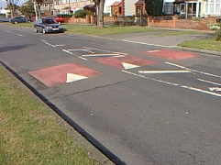
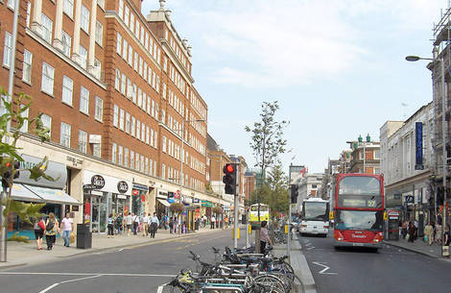
Movement and place
ENGINEERING SOLUTIONS infrastructure
Greater emphasis on movement
1930s: Super segregation proposed
1950s-1970s: Segregation but hierarchical
1980/90s: Traffic calming
Early 2000s: Home Zones
Mid 2000s: Naked streets
2007 Manual for Streets
Late 2000s: Shared Space
Late 2000s: DIY Streets
Late 2000s: 20mph zones/areas
Late 2000s: Link/place proposed
Greater emphasis on place

Slide 19
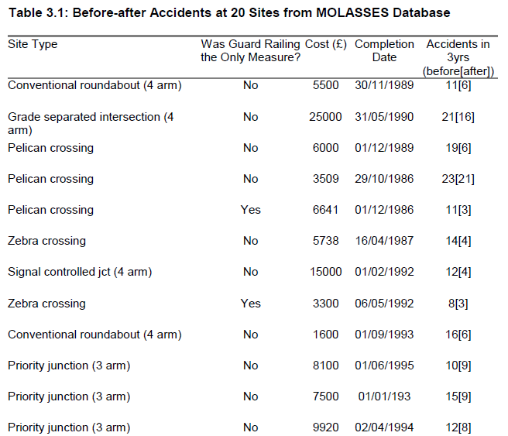
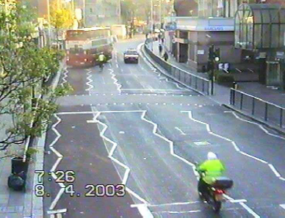
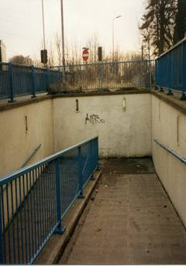
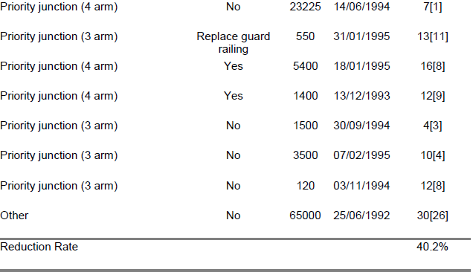
ENGINEERING SOLUTIONS infrastructure
Segregation
  Does it work?
  Side effects

Slide 20
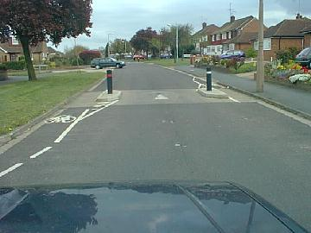
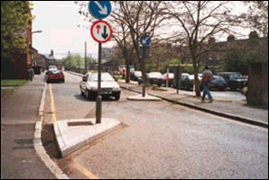
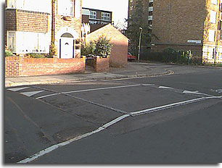

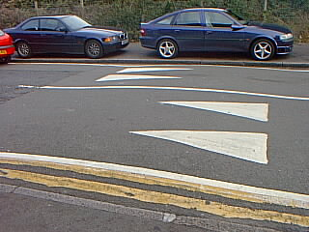
Traffic calming types in the UK
ENGINEERING SOLUTIONS infrastructure
Pinch points
Chicanes
Speed or flat-topped tables
Speed cushion
Speed humps

Slide 21
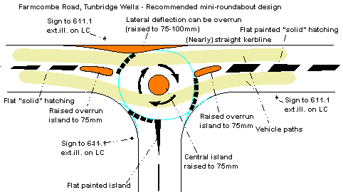
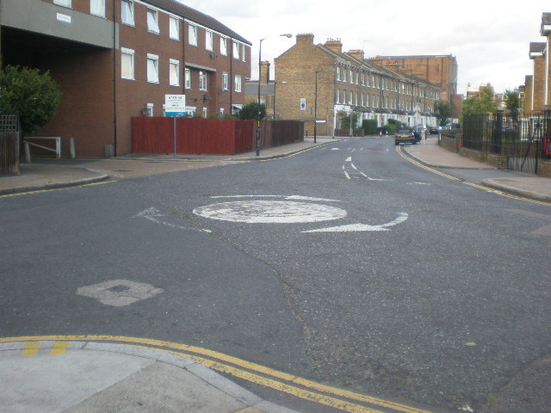
Traffic calming types in the UK
ENGINEERING SOLUTIONS infrastructure
Mini roundabout

Slide 22
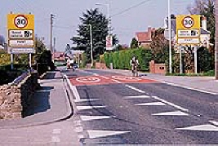
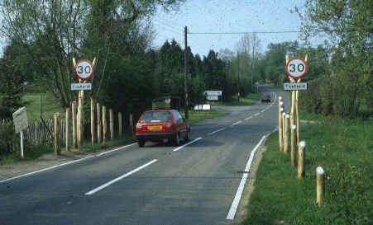
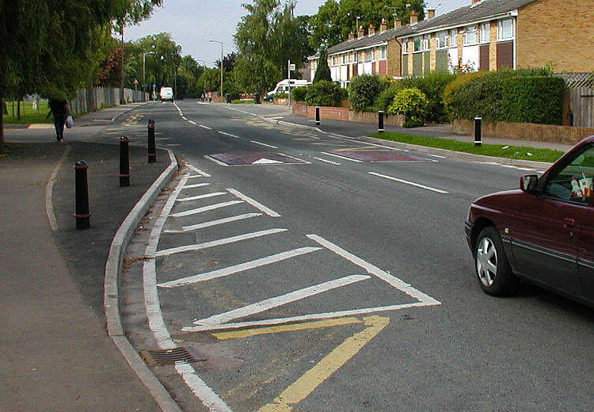
Traffic calming types in the UK
ENGINEERING SOLUTIONS infrastructure
Gateway
Narrowings

Slide 23
Traffic calming
ENGINEERING SOLUTIONS infrastructure
Reduction in speed
  Which speed measure to use
  Fastest speeds?
Reduction in amount of traffic
  But where to?
  Reduction in accidents
    Though low numbers before and after
Poorer road positioning
  More difficult to predict driver behaviour
Increase in delay to emergency vehicles
Increase in pollution
  Noise
  Vibration
Poorer bus rides

Slide 24
Shared space
ENGINEERING SOLUTIONS infrastructure
“Providing less complex and ‘self-explaining’ roads, which have clear signage and road markings as well as intuitive infrastructure is likely to benefit all road users, in addition to the older driver” (Box et al., 2010; pg. 43)
Vs.
Creating a more complex to encourage sharing of space and a levelling of priorities amongst different users (Engwicht, 1992; Hamiton-Baillie and Jones, 2005).
This should help reduce speeds of drivers who have to informally negotiate the space with other road users and the ambiguity of the road scene.
But we don’t know the tipping point between the two?
  what may create complexity and additional attention amongst a younger driver may well be very different to that of an older driver who could find a highly complex environment too difficult to negotiate and actually increase the likelihood of an accident.
  Further research is needed to examine the interaction between infrastructure design and the affect on ability and skill of older drivers.

Slide 25
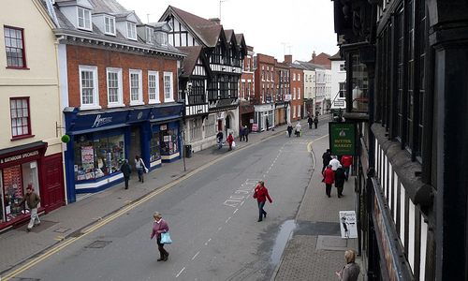
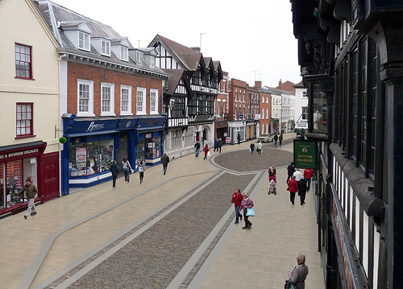
Shared space
ENGINEERING SOLUTIONS infrastructure
Evidence it works?
TRL 661
Reid, S Kocak, N and Hunt, L (2009) DfT Shared Spaces Project – Stage 1: Appraisal of Shared Space. MVA Consultancy.
Hammond, V. and Musselwhite, C B A (2013). The attitudes, perceptions and concerns of pedestrians and vulnerable road users to shared space: a case study from the UK. Journal Of Urban Design 18(1), 78-97.
Evidence against it
Moody, S. and Melia, S. (2011) Shared space - implications of recent
research for transport policy. Transport Policy . ISSN 0967-070X
See http://eprints.uwe.ac.uk/16039/1/Shared%20Space%20-%20Implications%20of%20Recent%20Research%20for%20Transport%20Policy.pdf
Imrie, R and Kumar, M (2010) ‘Shared Space and Sight Loss: Policies and Practices in English Local Authorities’. Thomas Pilkington Trust. January 2010.

Slide 26
Driving tests, learners and safety
EDUCATION
750,000 qualify for car driving licence each year (DfT, 2007)
Majority of people felt test did not adequately prepare driver for the road (Christmas, 2007)
Probably quite justified – first 6 months of driving over represented in accident statistics (esp. youngsters) (DfT, 2008; Emmerson, 2008)
Learner drivers have poor conceptualisation of what makes a good driver (Emmerson, 2008)
Learning really begins after the test was a view consistently held but reluctant to take formal training (Christmas, 2007)
  Learning from experience
  Learning from mistakes
  Forming habits and learning norms
Notes:
20% think test too easy – 71% not easy – why not use difficult to easy?
Do not prepare drivers for m’ways, only assess in one moment of time, assessors have quotas to meet etc.
Learning really begins after test – emphasises the importance of learning norms and habits of the road not formal written rules.

Slide 27
EDUCATION
Driving tests, learners and safety
Time for radical review of driving learning and test (DSA consultation 2008)
Test requires no formal learning and hasn’t been radically changes since being introduced in 1935
DSA propose
  Lifelong learning
  Improving ecological validity
  Cover social aspects of the road
  Formalise learning arrangements
  Group based learning
    Implementation intentions work in localised conditions (Elliott and Armitage, 2006)
    Thames Valley Speed Course – some effect on change in attitude and behaviour especially on 30mph residential roads, but not motorways (McKenna and Poulter, 2008)

Slide 28

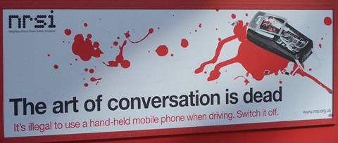


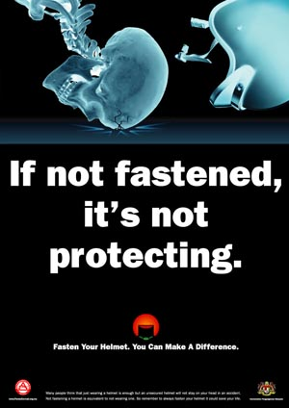
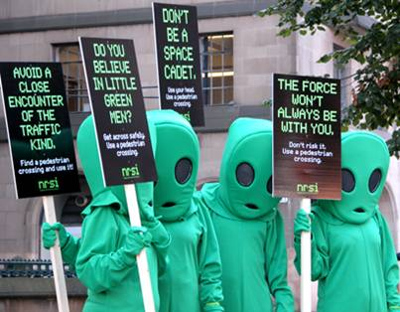

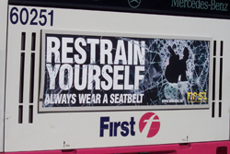
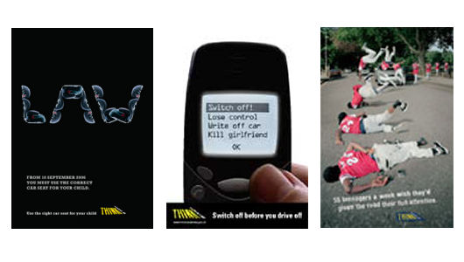
EDUCATION

Slide 29


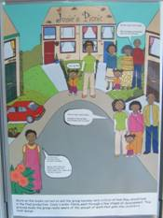

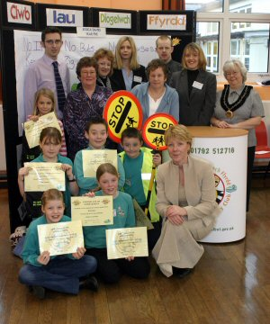


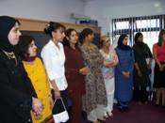
EDUCATION

Slide 30
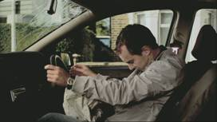
Context, theory and interventions
EDUCATION
ROAD SAFETY CAMPAIGNS
Despite widespread deployment, little evidence to suggest attitude and behaviour change (O’Connell, 2002; Thomas et al., 2007)
  Incurable optimism leads people to believe message is not for them (O’Connell, 2002)
  Driver can give drivers an excuse for their behaviour – problem is with other drivers (Silcock, et al.,1999)
  Fear inducing adverts have very little effect on driver attitudes and behaviour (Fylan et al., 2006)
Could be methodological problems as much as campaign themselves (Dragutinovic and Twisk, 2006)
Lack of theory cited behind the development of the message
  “Popular psychology” approach
        Vs.
  Theory-led non-reality approach
Notes:
Not much support for campaigns
Self-appraisal - overconfidence
Self vs others – not believe message is for them

Slide 31
Summary
EDUCATION
ROAD SAFETY CAMPAIGNS
Changes in attitude and behaviour difficult to monitor and evaluate effective education and campaigns.
Ownership of learning/need to change
Life-long learning
Group discussion and social context
In-situ
  Psychological and geographical difference
  Making it feel real

Slide 32
Context
ENFORCEMENT
SEAT BELT USE
Compulsory to fit front seat-belts to new cars from 1967.
Voluntary use encouraged through clunk-click campaign in 1970s
  Seat-belt use around 40%
Law to wear seat-belts in front of vehicle from 31st January 1983 (3 year trial then permanent from 1986)
  Seat belt compliance 90%
Rear seat-belt use 17% up to 40% in 1991 when made compulsory
  Up to 85% in 2008 (higher for children) with associated campaigns
However, of 1,432 car occupants killed in 2007, 34% had not belted up and of these 370 could have survived if properly restrained.

Slide 33
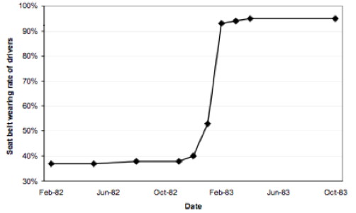

Slide 34
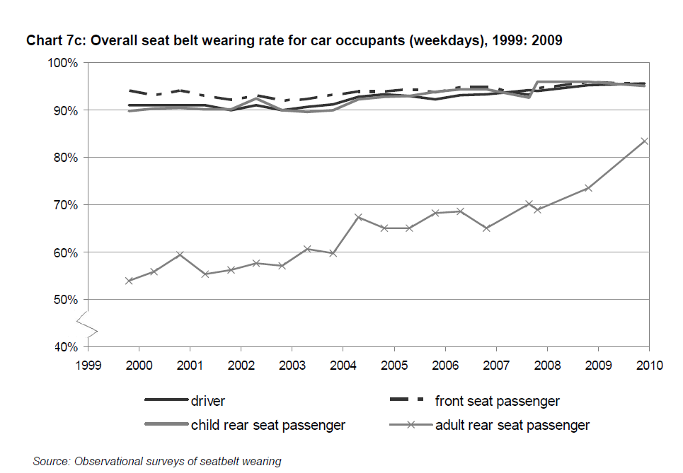

Slide 35
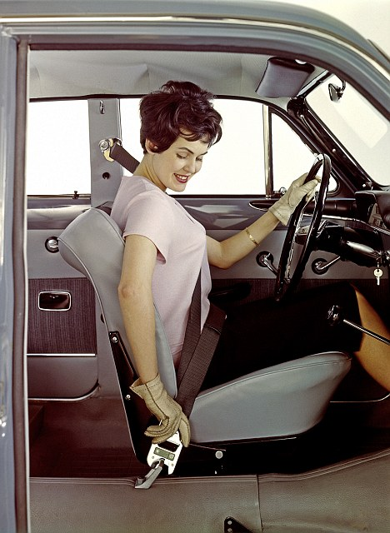
High compliance
ENFORCEMENT
SEAT BELT USE
SEAT BELT USE
Compliance behaviour is clear and unambiguous
Legislation was initially heavy but without fines
Associated successful campaigns
Behaviour is easy to perform
Little associated perceived costs or risk
Image is positive

Slide 36
Context
ENFORCEMENT
DRINK DRIVING
High support and compliance for drink-driving laws
High support for drink-driving laws (Higginson, 2005)
  Clamp-down on drink-driving is positively perceived (RAC, 2007)
  Support for high penalties – 72% suggest drink-drivers should get a ban of 5 years (DfT, 2008)
  94% support a more severe penalty
  85% think limit should be no drinks at all (DfT, 2008)
Women and those in lower socio-economic groups are more punitive (DfT,2008).
15-19 year old boys more tolerant than girls about drink-driving (O’Brien et al., 2002) but is still unacceptable amongst youngsters (Thomas et al., 2007)
Drink-driving known to be major cause of road accidents (Cauzard, 2003; Fuller et al., 2008)
75% thought the public were unable to judge how much they can drink before being over the drink-drive limit, but felt they were able to themselves!
Driving on cannabis thought to be more acceptable than drink-driving according to 15-19 year olds (Thomas et al., 2007).
Substantial number of drivers who still find it acceptable to have at least 2 drinks and drive (Higginson, 2005)

Slide 37
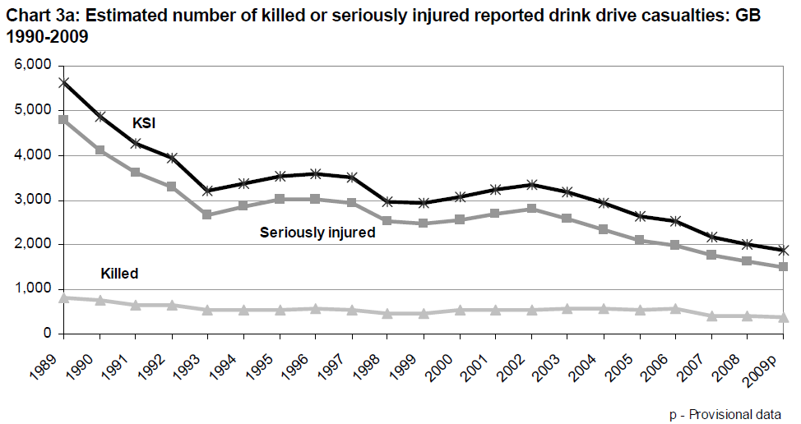
Context
ENFORCEMENT
DRINK DRIVING
DRINK DRIVING
But high number still drink-drive
Serious accidents, (fatalities and serious casualties) involving drink-driving are falling over past 20 years but slight casualties are increasing.
  Reported casualties: 11,190 (5% of all road accident casualties)
  Fatalities 380 in 2009 (11% of all road accident fatalities)
  Serious injured 1,480
  Slight casualties 10,130

Slide 38
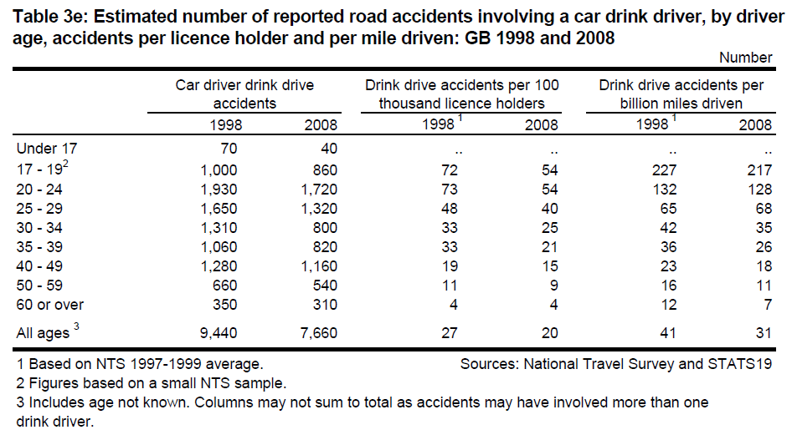
Legislation
ENFORCEMENT
DRINK DRIVING
DRINK DRIVING
44% of population have driven after drinking some alcohol in previous year
8-9% of population believed they had driven over the limit in last year
Most likely to be 17-29 year old males (25% admitted to driving over limit in previous year).
Also 17-25 year olds over represented in accident stats relating to alcohol.

Slide 39
Legislation
ENFORCEMENT
DRINK DRIVING
DRINK DRIVING
Legislation is quite tough
Around 500,000 breath tests carried out a year of which around 100,000 are found to be positive.
Limit in UK is 80mg alcohol per 100ml of blood (most EU countries are 50mg/100ml and Sweden is 20mg/100ml)
Endorsement for drink-driving remains on licence for 11 years
Max imprisonment for driving over limit is 6 months and a fine of £5000 and a minimum ban of 12 months of driving
Causing death by dangerous driving carries maximum 14 years in prison and a minimum 2 year driving ban (and requirement to take extended driving test before being able to drive again)

Slide 40
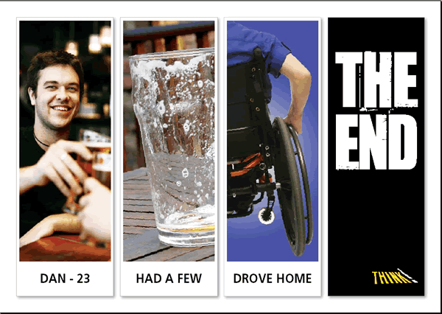
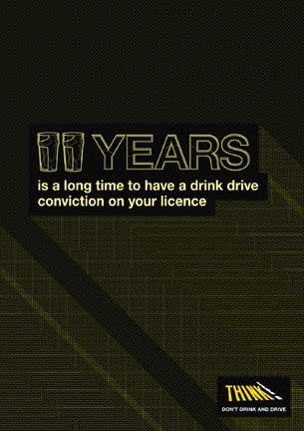
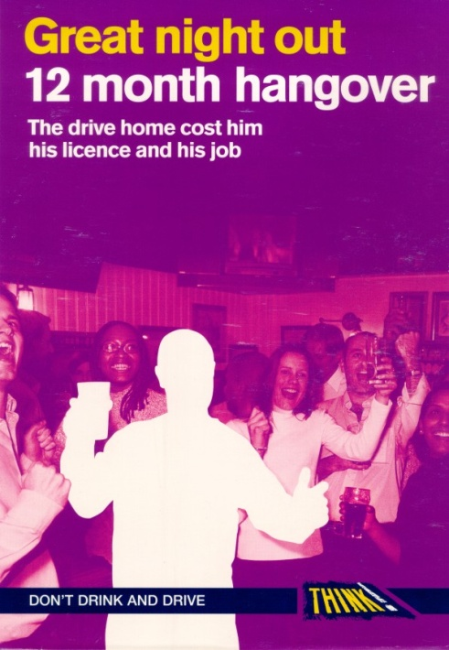
Evaluation
ENFORCEMENT
DRINK DRIVING
DRINK DRIVING
Works quite well
Tough and harsh penalties
  Random breath tests
Associated campaigns
  Shock
  Aftermath
Tackling drink-culture and social pressure not to drink-drive
More could be done
Pub bus
Zero tolerance.
But…
Ambiguity over limit
Social pressure?

Slide 41
Summary
ENFORCEMENT
DRINK DRIVING
Non ambiguous behaviour to comply to law
Harsh penalties and enforcement
Associated campaigns
  Shock tactics but also…
  Aftermath – the social consequences for ordinary life.
Need to tackle social acceptability and the wider social context within which such behaviours occur

Slide 42
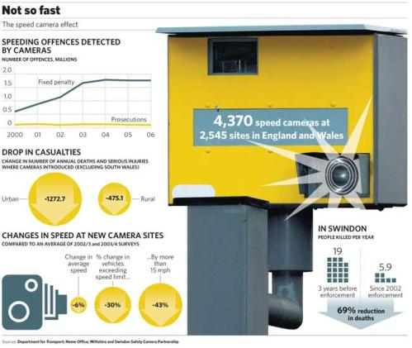
Speed cameras (1)
ENFORCEMENT
Notes:
Not sure whether support for speed cameras is falling, is consistent or is growing – need to look at the disaggregate level – who is more or less in favour and why? What might grow acceptability of speed cameras?

Slide 43
Speed Cameras (2)
ENFORCEMENT
More on this
So they work?
Yes…
Studies have shown that a reduction in the speed limit to 20mph in built-up areas causes a 60 per cent fall in accidents
Evidence from Swindon showed a 30 per cent reduction in the numbers of people killed or injured since cameras were installed
At 10 of the sites in Swindon where cameras were introduced, no road accident deaths have been recorded
No...
Critics say it's not speed that kills but tiredness and careless driving. It's this that should be targeted with safer driving campaigns
Speed cameras are being used as an easy way for the authorities to bump up their revenues, antagonising the public
Cameras are counter-productive in creating a tendency for drivers to break the speed limit when they are not around

Slide 44
Road Safety Audit
The Road Safety Audit is an “evaluation of Highway Improvement Schemes to identify potential road safety problems that may affect any users of the highway and to recommend measures to eliminate or mitigate these problems”. It is now considered by many council officials as an essential, integral part of town planning and many private organisations now consider it at least desirable and often essential.
The Auditors need to take all road users into account, particularly vulnerable users such as pedestrians and pedal cyclists.
Having identified any potential road safety problems, the Auditors then make recommendations of possible solutions. The client then reviews the findings of the Road Safety Audit, deciding which recommendations to accept, and therefore implement within the scheme design and construction. For those recommendations that are not accepted, good reason should be given.

Slide 45
Road safety Audit
Road Safety Audits are undertaken at various stages of the highway improvement scheme and comprise:-
  Stage 1 – Completion of preliminary design
  Stage 2 – Completion of detailed design
  Stage 3 – Completion of construction
  Stage 4 – Monitoring (12 months and 36 months)
A stage 1 and 2 Road Safety Audit are quite often combined.
Road Safety Audits can be requested for:
  Major and minor highway improvements
  Traffic management and calming schemes
  Pedestrian and cycling schemes
  New and amended junctions
  Motorway improvements
Road Safety Audits are undertaken by an Audit Team, which must be independent to the Design Team.
  The Audit Team comprises of a minimum of two persons with appropriate levels of training, skills and experience in Road Safety Engineering and/or Accident Investigation.
  The members of the Audit Team may be drawn from within the Design Organisation or from another body.
Site visits are a specific requirement of the Audit and both day time and night time visits are usually required in the later Audit stages.

Slide 46
Conclusion
  Road user safety solutions – the three Es
    Education, educate the driver
    Enforcement, restrict the driver
    Engineering, aid or take over from the driver
Road safety audit

